Slide 1
Operating systems Course Introduction

Slide 2
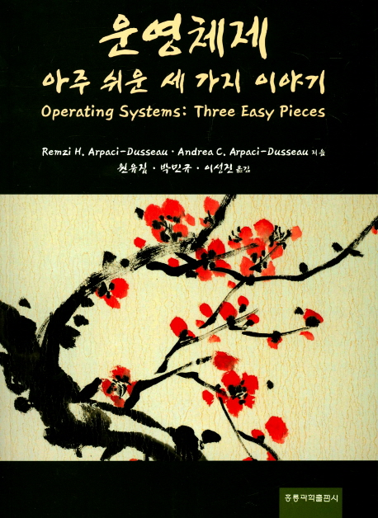
학습 개요
도서명
운영체제 - 아주 쉬운 세 가지 이야기
저자
원유집 외 역
출판사
홍릉과학출판사
출간일
2017년 2월
ISBN
9791156004899

Slide 3
학습 일정
학습 성취도 및 일정에 따라 유동적으로 바뀔 수 있음
주차 | 강의 내용
1 | 학습 개요 / 운영체제 소개 (2장)
2 | 가상화와 프로세스의 개념 (3장 4장)
3 | 프로세스 API와 제한적 직접 실행 원리 (5장 6장)
4 | 스케줄링 개요 (7장 8장)
5 | 멀티 프로세서 스케줄링 (9장 10장)
6 | 메모리 가상화의 개념 (11장 12장)
7 | 주소공간의 개념 (13장 14장)
8 | 중간고사
9 | 주소변환의 원리와 세그멘테이션 (15장, 16장)
10 | 페이징의 개념 (17장, 18장)
11 | TLB의 개념 (19장, 20장)
12 | 물리 메모리 크기의 극복 (21장, 22장)
13 | VAX/VMS 가상 메모리 시스템 (23장, 24장)
14 | 병행성의 개념 (25장, 26장)
15 | 기말고사

Slide 4
평가 기준
출 석 | 10 점
중간고사 | 30 점
기말고사 | 40 점
실습과제 | 20 점
총 점 | 100 점
결석 1회 : 2점 감점
지각 1회 : 1점 감점

Slide 5

바다와 육지가 만나는 지점

Slide 6
Why learn about Operating Systems?
Tangible reasons
Build or modify a real operating system
Administer and use system well
Tune application performance
Intangibles
Intrinsic curiosity
Understand how your computer works
Gain/apply knowledge in other areas of Computer Science
Computer architecture and devices
Synchronization in programming languages
Data structures and algorithms
Performance analysis
Challenge of designing large, complex systems

Slide 7
What is an operating System
Not easy to define:
Users
Applications
Operating System
Hardware
OS:
Everything that isn’t an application or hardware
OS:
Software that abstract hardware into a useful form for applications
Standard Library
Resource Coordinator

Slide 8
First Function: Standard Library
Advantages of standard library
Allow applications to reuse common facilities
Make different devices look the same
Provide higher level abstractions
Challenges
What are the right
abstractions?

Slide 9
Second Function: Resource Coordinator
Resource: “Anything valuable”
(e.g. CPU, memory, disk, network)
Advantages of resource coordinator
Virtualize resource so multiple users/applications can share
Protect applications from one another
Provide efficient and fair access to resources
Challenges
What mechanisms?
What policies?

Slide 10
What Functionality in OS?
No single right answer
Desired functionality depends on outside factors
Expectations
Technology
Changes
Users &
Applications
Operating
System
Computer
Architecture
OS must adapt
Change abstractions provided to users
Change algorithms to implement those abstractions
Change low-level interfaces to deal with new hardware
Current operating systems driven by technological evolution

Slide 11

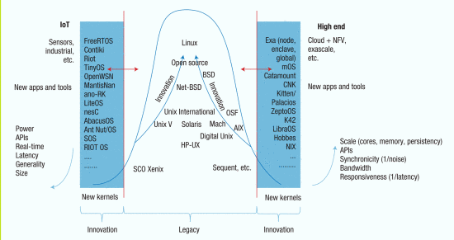
Outlook on Operating Systems
“Will OSs in 2025 still resemble the Unix-like consensus of today, or will a very different design achieve widespread adoption?”
Dejan Milojicic and Timothy Roscoe. 2016. Outlook on Operating Systems. Computer 49, 1 (January 2016), 43-51. DOI=http://dx.doi.org/10.1109/MC.2016.19
http://ieeexplore.ieee.org/document/7383138/

Slide 12
Types of OSes
Monolithic kernels
Linux, Windows, BSDs, …
UniKernel / Library OS
SunMOS, Mirage, …
Exokernels
Microkernels
MINIX
Multi-kernels
Barrelfish
Lightweight Kernels
Catamount, IBM CNK
Co-kernels
McKernel, Intel mOS

Slide 13
Operating System Architectures
What do the applications really need?
Really: “What do we think the applications need?”
What abstractions should OS provide?
Abstractions == Combination of mechanisms and policies
Performance
OS abstractions add overhead
Hardware Capabilities
OS abstractions inherently reduce the capabilities of the hardware
Working with “others”
OS abstractions determine how applications communicate
Isolation
OS abstractions determine amount of isolation
Both for security and performance

Slide 14
Monolithic Kernels
Defacto standard OS design approach
Linux, Windows, etc
Goal is universal compatibility
Support all possible hardware
Support all possible applications
Easy to use
Does everything “good enough”
Many high level abstractions
Large and complex
Linux kernel source code is 850MB
Constant security vulnerabilities

Slide 15
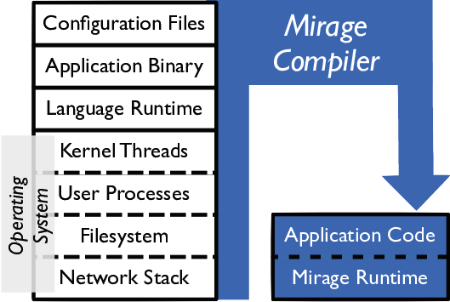
Unikernel
Link OS to application as a library
Application and OS are a single entity
OS Library:
Abstractions to interface directly with hardware
Policies to manage isolation in application
Very high performance
Minimal and highly specialized abstractions
No context switching
No protection!
Application runs as the kernel
Application has control over entire machine
Very low system utilization
Only one application at a time can run on a machine

Slide 16
Unikernel use cases
Supercomputing / HPC
Historically extreme scale HPC systems have run a single app at a time
1990’s – early 2000’s
Early OS’s could not scale
Unikernels were adopted to “fill the gap”
Fell out of favor as OSes (Linux) caught up
Cloud (Virtual Machines)
Virtualization sparked a renaissance in unikernels
Performance benefits without the costs
Multiple virtualized unikernels can run on a single system
Unikernels can actually increase cloud system utilization
Why?

Slide 17
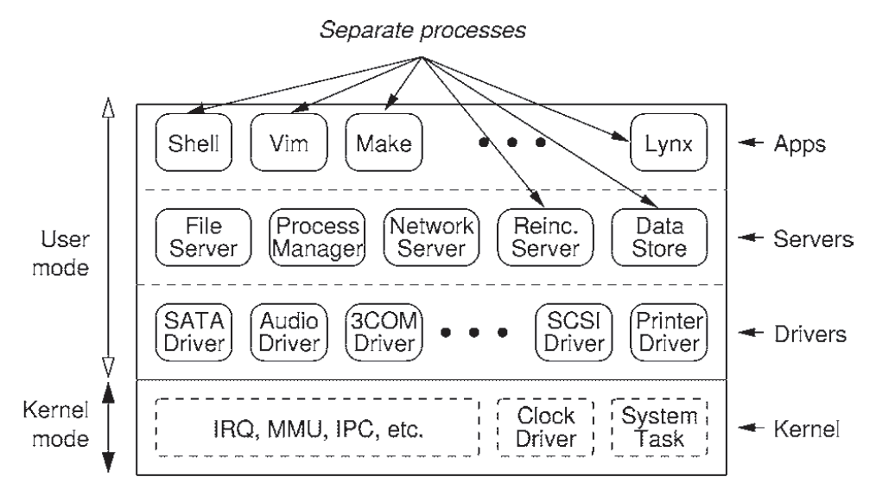
Microkernels
Minimalistic kernel
Provide very few mechanisms
Basic HW protection/isolation and IPC channels
Higher level abstractions implemented in user space as “servers”
Clients request functionality from a specific server
OS as a distributed system (designed by Tannenbaum)
Client-server communicate via message passing
Performance depends on a very fast message passing mechanism (the most important OS mechanism)
Why Message Passing for IPC?

Slide 18
Exokernels
A combination of micro- and uni- kernels
Very small kernel provides basic HW protection
No OS provided IPC mechanisms
Applications provide own higher level services
Applications can choose their level of abstraction
Implement their own services

Slide 19
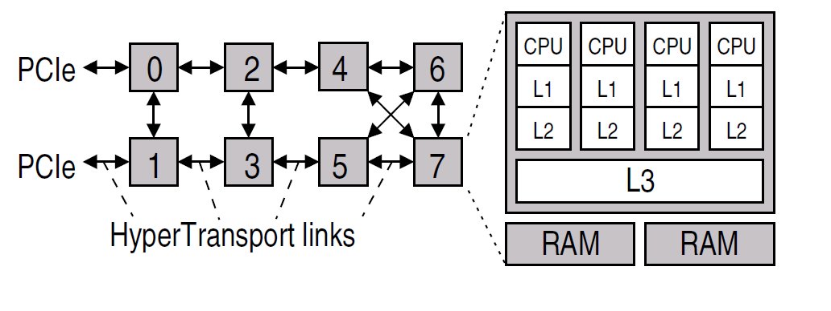
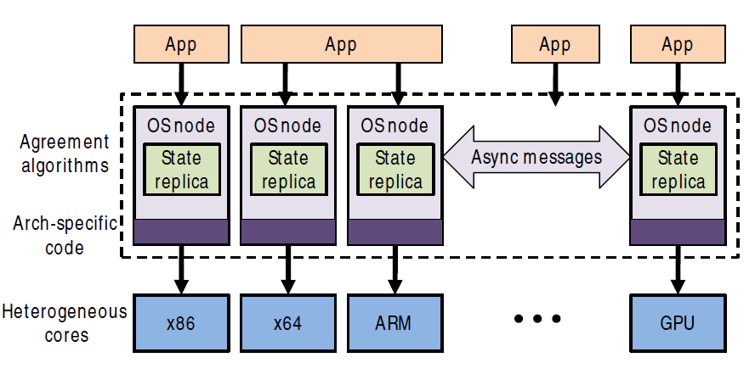
Multi-kernels
Goal: Make microkernels scalable to modern systems
Modern many-/multi-core systems are basically distributed systems
Distributed Operating System
Communicate via asynchronous messages
Shared memory doesn’t work in a distributed system
Replicate state, but use messages to keep it consistent
Support heterogeneous architectures

Slide 20
Lightweight kernels (LWKs)
Designed specifically for extreme scale HPC
Large scale supercomputers in the upper ranks of the top 500 (http://www.top500.org)
Large scale, but small world
Small number of applications
Small number of application requirements
Small number of systems
LWKs provide a stripped down OS environment
Provide the OS features needed and nothing else
“Leaky” microkernel
Will provide functionality in OS when it makes sense

Slide 21
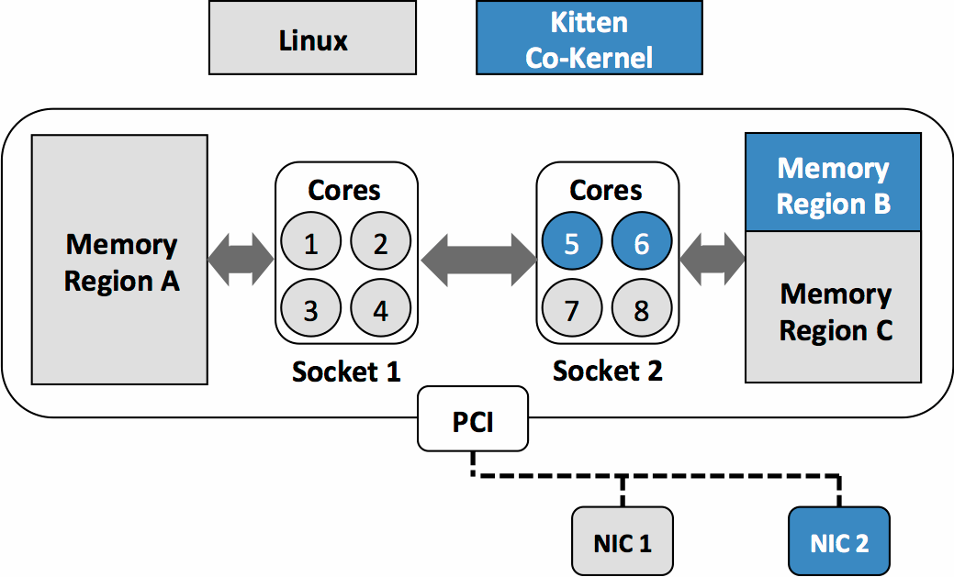
Lightweight Co-kernels
Fact: Programmers are lazy
Everyone just wants to use Linux
LWKs lack many Linux features (i.e. shells)
Co-kernels couple an LWK and a FWK (Linux) on the same machine
Missing features in LWK can be provided by Linux
Machine can be managed via Linux
Applications can be launched onto an LWK partition
Best of both worlds
Functionality of Linux
Performance of an LWK for HPC Apps
Non-interference between the two partitions

Slide 22
Hypervisors/VMMs
A Virtual Machine is a software version of the hardware state of a computer system
An operating system running within a virtual machine is called a guest operating system

Slide 23
Virtual Machine Monitors (VMMs)
Virtual Machines run an OS as an application
Implements hardware interface in software
Ways to build a VMM (Type 1 vs Type 2)
Type 2: VMs run as apps in a native OS
VMWare Player, KVM, VirtualBox
Type 1: Hypervisor is the native OS
No native apps, everything runs in a VM
Xen, VMWare ES

Slide 24
02. Introduction to Operating Systems
임종범
jblim@kpu.ac.kr

Slide 25
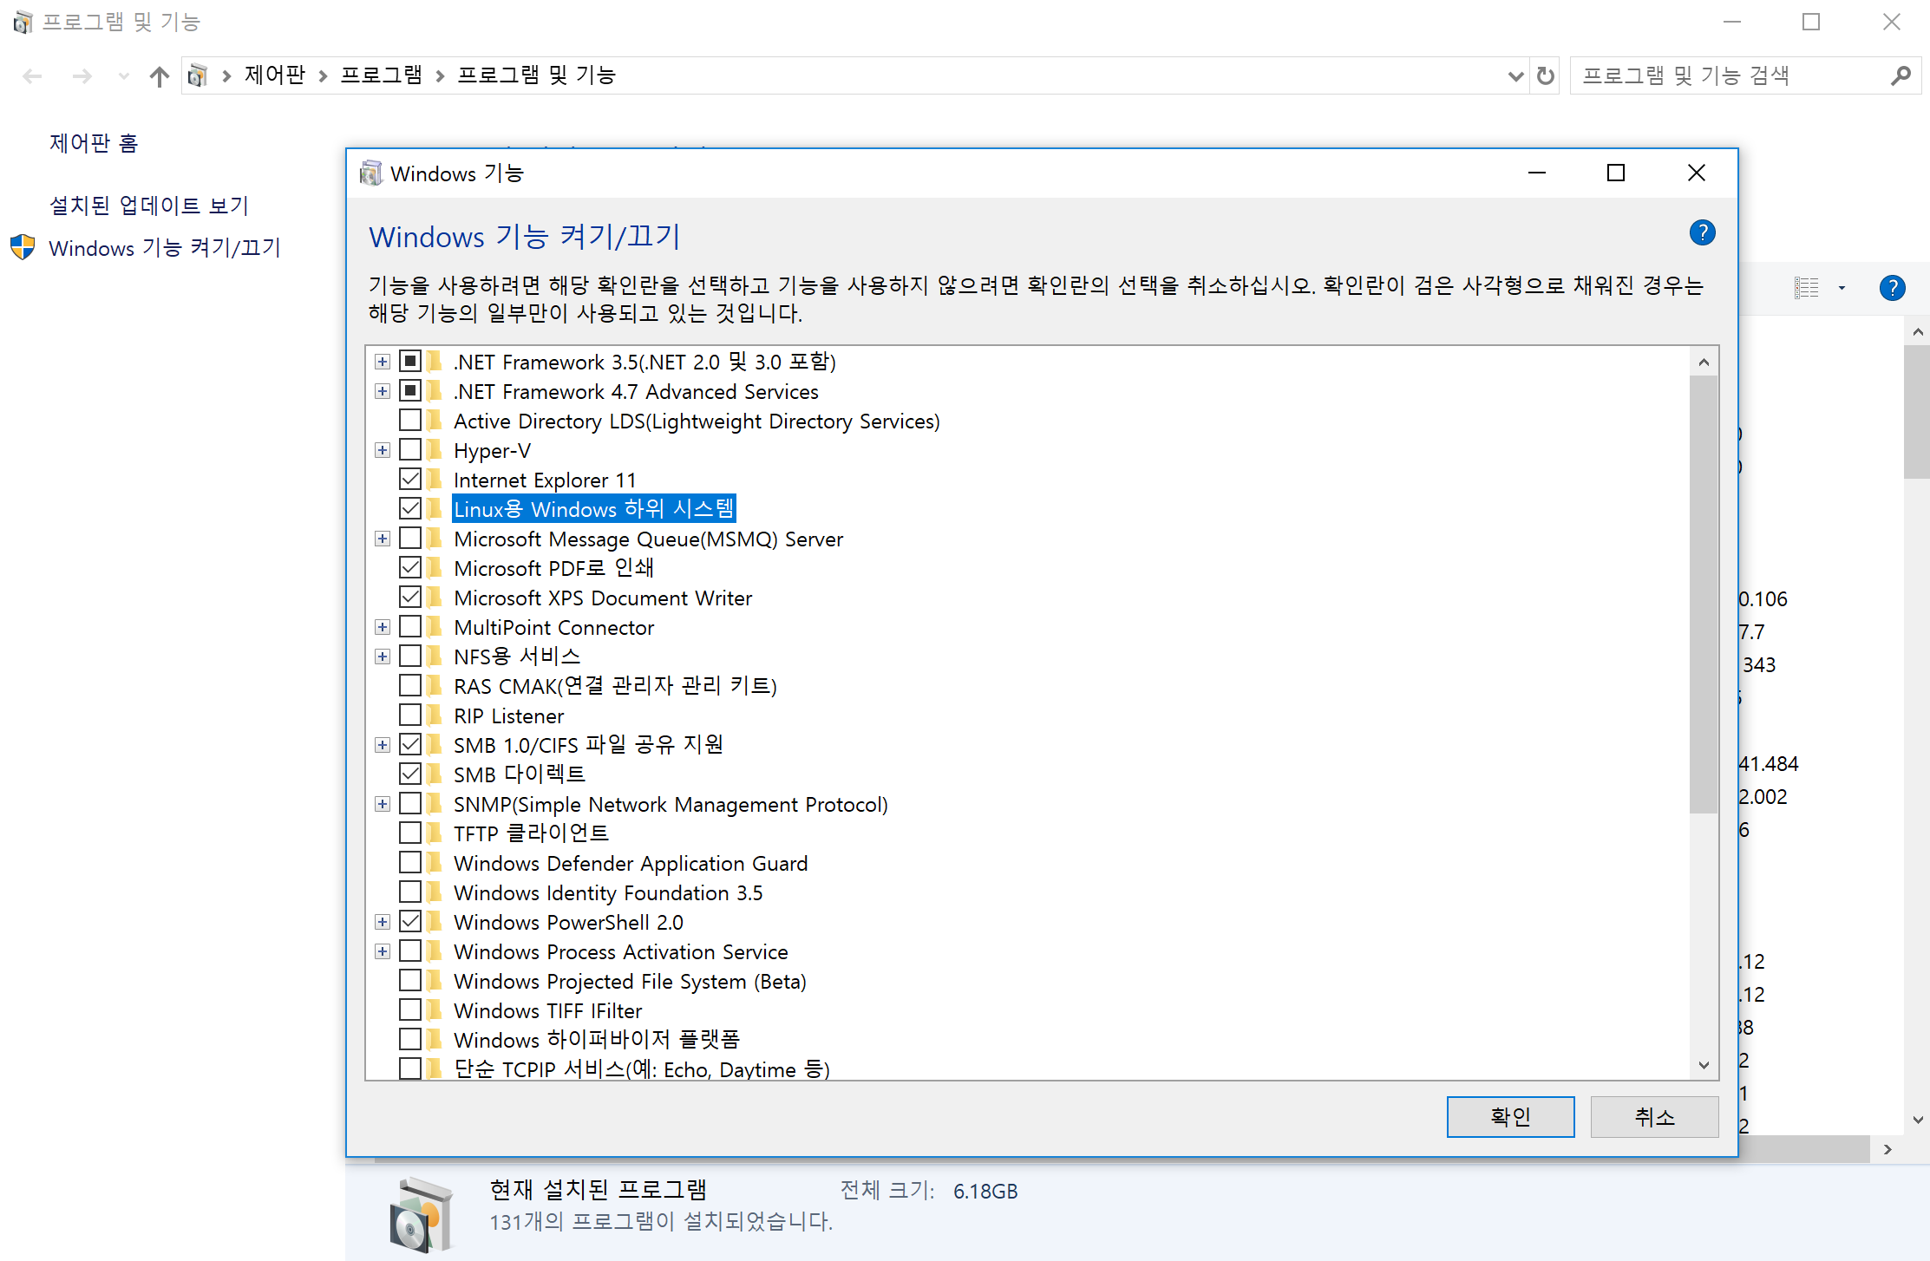
Linux environment
https://docs.microsoft.com/en-us/windows/wsl/install-manual

Slide 26
What a happens when a program runs?
A running program executes instructions.
The processor fetches an instruction from memory.
Decode: Figure out which instruction this is
Execute: i.e., add two numbers, access memory, check a condition, jump to function, and so forth.
The processor moves on to the next instruction and so on.

Slide 27
Operating System (OS)
Responsible for
Making it easy to run programs
Allowing programs to share memory
Enabling programs to interact with devices
OS is in charge of making sure the system operates correctly and efficiently.

Slide 28
Virtualization
The OS takes a physical resource and transforms it into a virtual form of itself.
Physical resource: Processor, Memory, Disk …
The virtual form is more general, powerful and easy-to-use.
Sometimes, we refer to the OS as a virtual machine.

Slide 29
System call
System call allows user to tell the OS what to do.
The OS provides some interface (APIs, standard library).
A typical OS exports a few hundred system calls.
Run programs
Access memory
Access devices

Slide 30
The OS is a resource manager.
The OS manage resources such as CPU, memory and disk.
The OS allows
Many programs to run → Sharing the CPU
Many programs to concurrently access their own instructions and data → Sharing memory
Many programs to access devices → Sharing disks

Slide 31
Virtualizing the CPU
The system has a very large number of virtual CPUs.
Turning a single CPU into a seemingly infinite number of CPUs.
Allowing many programs to seemingly run at once → Virtualizing the CPU

Slide 32
Virtualizing the CPU (Cont.)
1 #include <stdio.h>
2 #include <stdlib.h>
3 #include <sys/time.h>
4 #include <assert.h>
5 #include "common.h"
6
7 int
8 main(int argc, char *argv[])
9 {
10 if (argc != 2) {
11 fprintf(stderr, "usage: cpu <string>\n");
12 exit(1);
13 }
14 char *str = argv[1];
15 while (1) {
16 Spin(1); // Repeatedly checks the time and returns once it has run for a second
17 printf("%s\n", str);
18 }
19 return 0;
20 }
Simple Example(cpu.c): Code That Loops and Prints

Slide 33
Virtualizing the CPU (Cont.)
Execution result 1.
prompt> gcc -o cpu cpu.c -Wall
prompt> ./cpu "A"
A
A
A
ˆC
prompt>
Run forever; Only by pressing “Control-c” can we halt the program

Slide 34
Virtualizing the CPU (Cont.)
Execution result 2.
prompt> ./cpu A & ; ./cpu B & ; ./cpu C & ; ./cpu D &
[1] 7353
[2] 7354
[3] 7355
[4] 7356
A
B
D
C
A
B
D
C
A
C
B
D
...
Even though we have only one processor, all four of programs seem to be running at the same time!

Slide 35
Virtualizing Memory
The physical memory is an array of bytes.
A program keeps all of its data structures in memory.
Read memory (load):
Specify an address to be able to access the data
Write memory (store):
Specify the data to be written to the given address

Slide 36
Virtualizing Memory (Cont.)
A program that Accesses Memory (mem.c)
1 #include <unistd.h>
2 #include <stdio.h>
3 #include <stdlib.h>
4 #include "common.h"
5
6 int
7 main(int argc, char *argv[])
8 {
9 int *p = malloc(sizeof(int)); // a1: allocate some memory
10 assert(p != NULL);
11 printf("(%d) address of p: %08x\n",
12 getpid(), (unsigned) p); // a2: print out the address of the memmory
13 *p = 0; // a3: put zero into the first slot of the memory
14 while (1) {
15 Spin(1);
16 *p = *p + 1;
17 printf("(%d) p: %d\n", getpid(), *p); // a4
18 }
19 return 0;
20 }

Slide 37
Virtualizing Memory (Cont.)
The output of the program mem.c
The newly allocated memory is at address 00200000.
It updates the value and prints out the result.
prompt> ./mem
(2134) memory address of p: 00200000
(2134) p: 1
(2134) p: 2
(2134) p: 3
(2134) p: 4
(2134) p: 5
ˆC

Slide 38
Virtualizing Memory (Cont.)
Running mem.c multiple times
It is as if each running program has its own private memory.
Each running program has allocated memory at the same address.
Each seems to be updating the value at 00200000 independently.
prompt> ./mem &; ./mem &
[1] 24113
[2] 24114
(24113) memory address of p: 00200000
(24114) memory address of p: 00200000
(24113) p: 1
(24114) p: 1
(24114) p: 2
(24113) p: 2
(24113) p: 3
(24114) p: 3
...
echo 0 | sudo tee /proc/sys/kernel/randomize_va_space

Slide 39
Virtualizing Memory (Cont.)
Each process accesses its own private virtual address space.
The OS maps address space onto the physical memory.
A memory reference within one running program does not affect the address space of other processes.
Physical memory is a shared resource, managed by the OS.

Slide 40
The problem of Concurrency
The OS is juggling many things at once, first running one process, then another, and so forth.
Modern multi-threaded programs also exhibit the concurrency problem.

Slide 41
Concurrency Example
A Multi-threaded Program (thread.c)
1 #include <stdio.h>
2 #include <stdlib.h>
3 #include "common.h"
4
5 volatile int counter = 0;
6 int loops;
7
8 void *worker(void *arg) {
9 int i;
10 for (i = 0; i < loops; i++) {
11 counter++;
12 }
13 return NULL;
14 }
15
16 int
17 main(int argc, char *argv[])
18 {
19 if (argc != 2) {
20 fprintf(stderr, "usage: threads <value>\n");
21 exit(1);
22 }

Slide 42
Concurrency Example (Cont.)
The main program creates two threads.
Thread: a function running within the same memory space. Each thread start running in a routine called worker().
worker(): increments a counter
23 loops = atoi(argv[1]);
24 pthread_t p1, p2;
25 printf("Initial value : %d\n", counter);
26
27 Pthread_create(&p1, NULL, worker, NULL);
28 Pthread_create(&p2, NULL, worker, NULL);
29 Pthread_join(p1, NULL);
30 Pthread_join(p2, NULL);
31 printf("Final value : %d\n", counter);
32 return 0;
33 }

Slide 43
Concurrency Example (Cont.)
loops determines how many times each of the two workers will increment the shared counter in a loop.
loops: 1000.
loops: 100000.
prompt> gcc -o thread thread.c -Wall -pthread
prompt> ./thread 1000
Initial value : 0
Final value : 2000
prompt> ./thread 100000
Initial value : 0
Final value : 143012 // huh??
prompt> ./thread 100000
Initial value : 0
Final value : 137298 // what the??

Slide 44
Why is this happening?
Increment a shared counter → take three instructions.
Load the value of the counter from memory into register.
Increment it
Store it back into memory
These three instructions do not execute atomically. → Problem of concurrency happen.

Slide 45
Persistence
Devices such as DRAM store values in a volatile.
Hardware and software are needed to store data persistently.
Hardware: I/O device such as a hard drive, solid-state drives(SSDs)
Software:
File system manages the disk.
File system is responsible for storing any files the user creates.

Slide 46
Persistence (Cont.)
Create a file (/tmp/file) that contains the string “hello world”
1 #include <stdio.h>
2 #include <unistd.h>
3 #include <assert.h>
4 #include <fcntl.h>
5 #include <sys/types.h>
6
7 int
8 main(int argc, char *argv[])
9 {
10 int fd = open("/tmp/file", O_WRONLY | O_CREAT | O_TRUNC, S_IRWXU);
11 assert(fd > -1);
12 int rc = write(fd, "hello world\n", 13);
13 assert(rc == 13);
14 close(fd);
15 return 0;
16 }
open(), write(), and close() system calls are routed to the part of OS called the file system, which handles the requests

Slide 47
Persistence (Cont.)
What OS does in order to write to disk?
Figure out where on disk this new data will reside
Issue I/O requests to the underlying storage device
File system handles system crashes during write.
Journaling or copy-on-write
Carefully ordering writes to disk

Slide 48
Design Goals
Build up abstraction
Make the system convenient and easy to use.
Provide high performance
Minimize the overhead of the OS.
OS must strive to provide virtualization without excessive overhead.
Protection between applications
Isolation: Bad behavior of one does not harm other and the OS itself.

Slide 49
Design Goals (Cont.)
High degree of reliability
The OS must also run non-stop.
Other issues
Energy-efficiency
Security
Mobility

Slide 50
Main frame computer
M360
Virtual Machine

Slide 51
Mini computer
PDP-11
Unix
Shell, pipe, signal

Slide 52
DOS, Windows, MAC

Slide 55
What lies all these behind…

Slide 56
What does OS deal with
CPU
Execute code with data
Memory
Read and write code and data
Storage
Persistently store the code and data

Slide 58
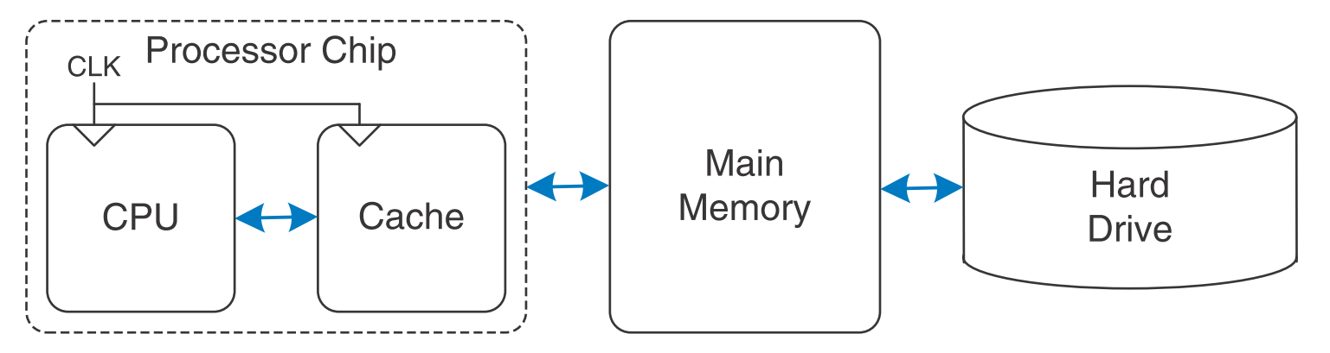

Slide 59
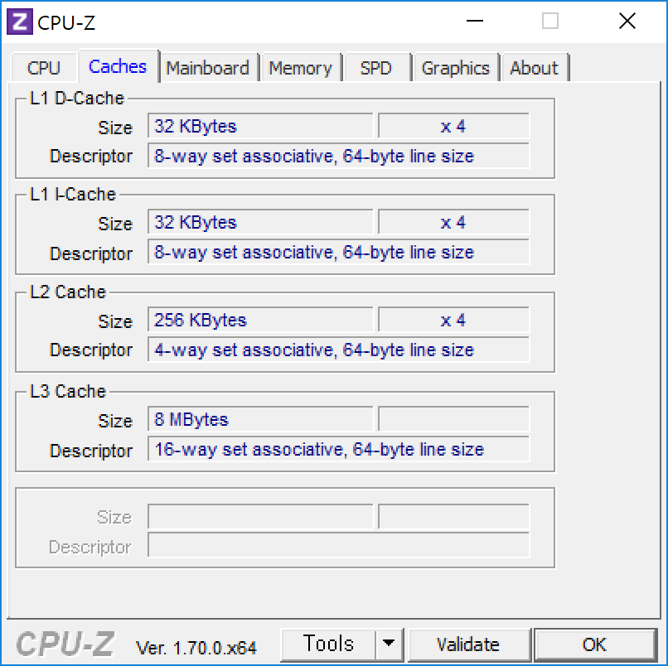
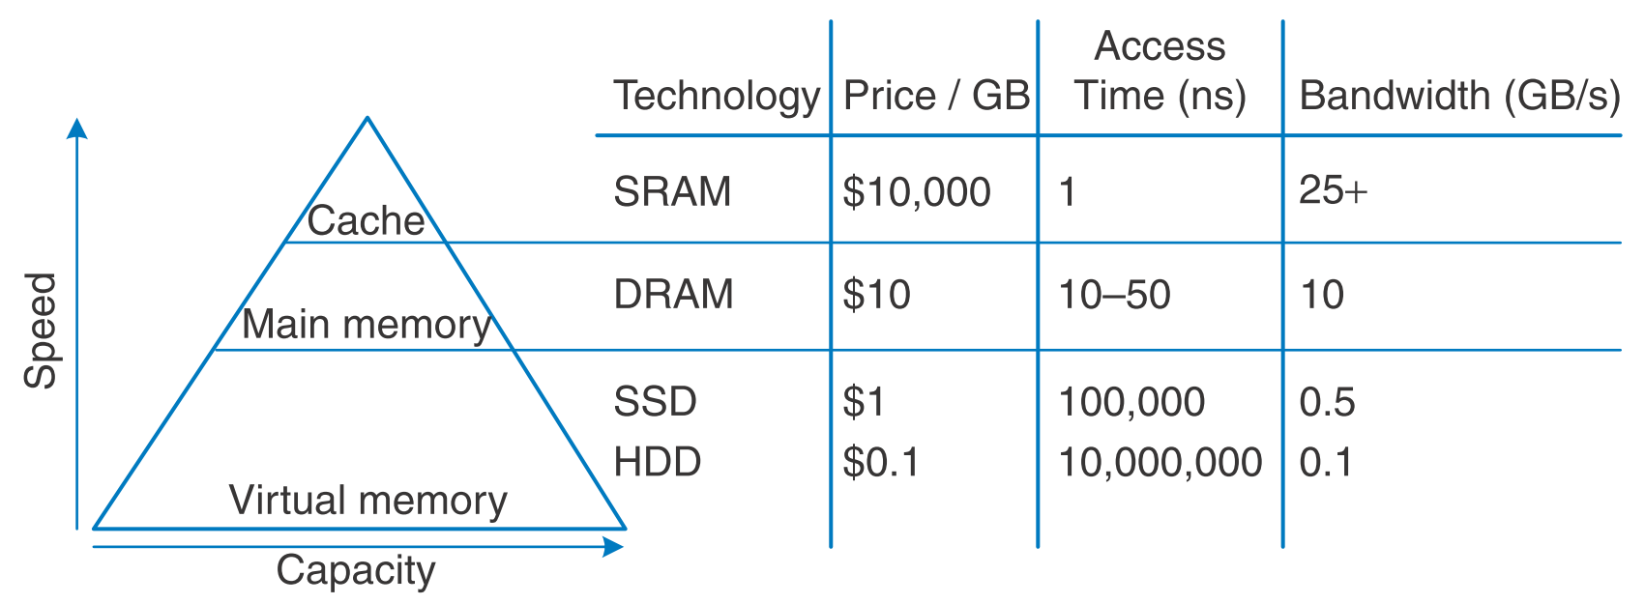

Slide 60
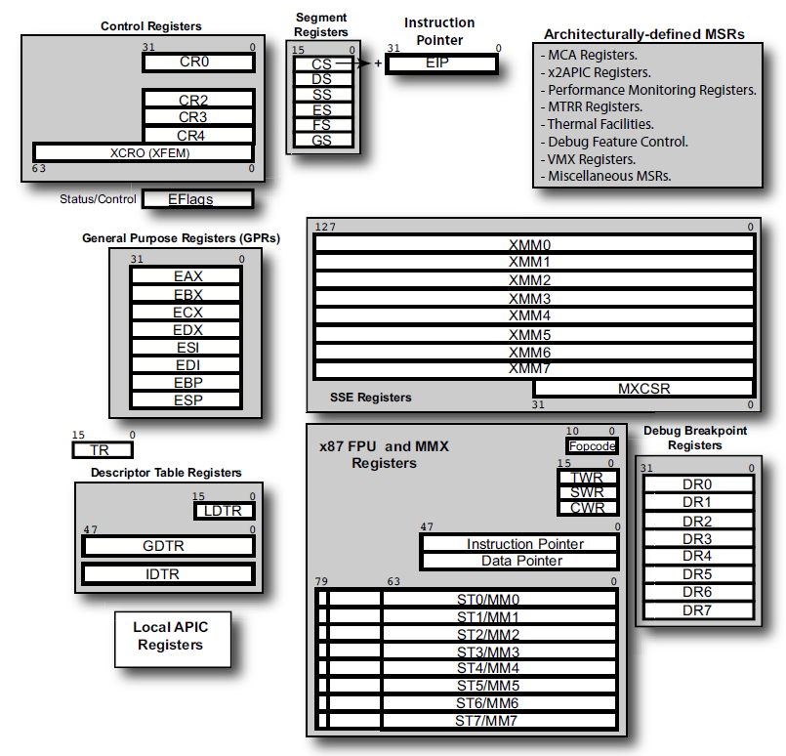

Slide 61
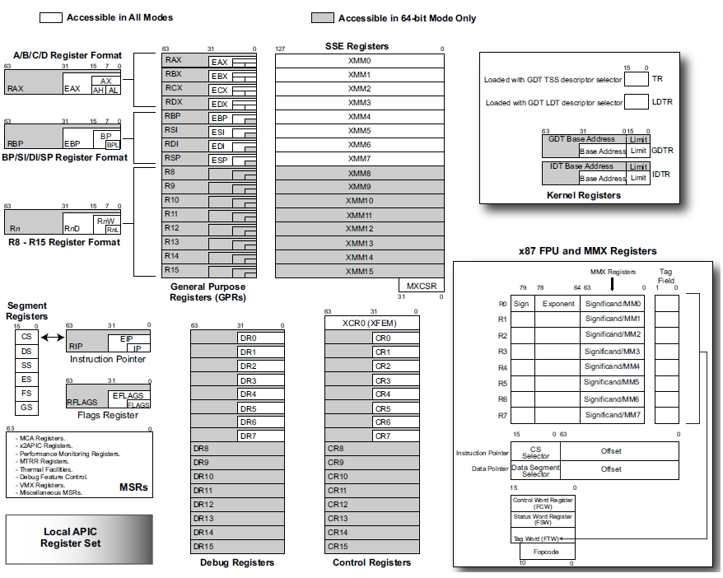

Slide 62
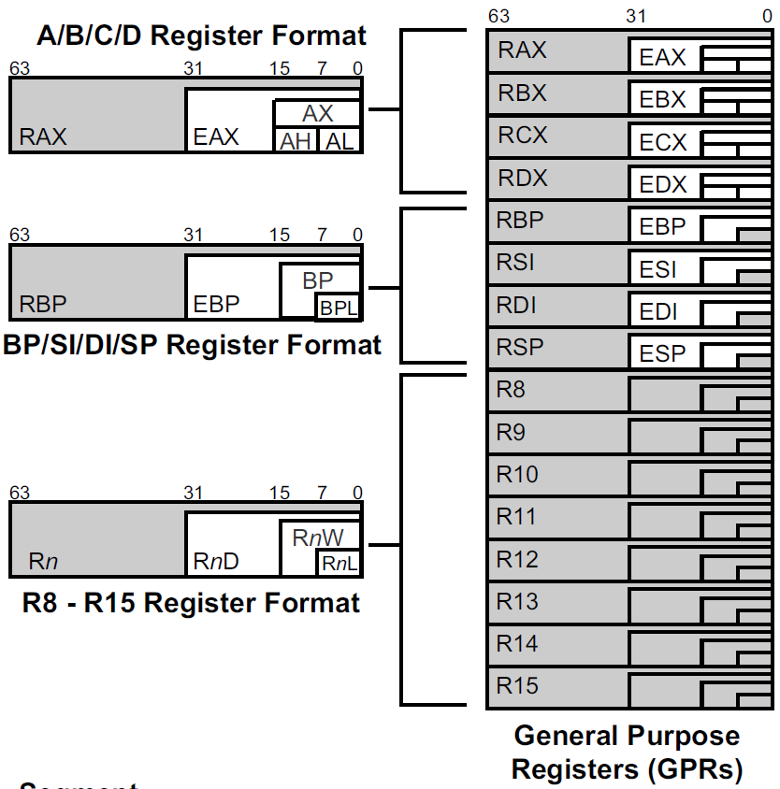
R8D
(“D” means a Doubleword access)
Dword = 4 bytes
R8W
(“W” means a Word access)
Word = 2 bytes
R8B
(“B” means a Byte access)
Quadword = Qword = 8 bytes

Slide 63
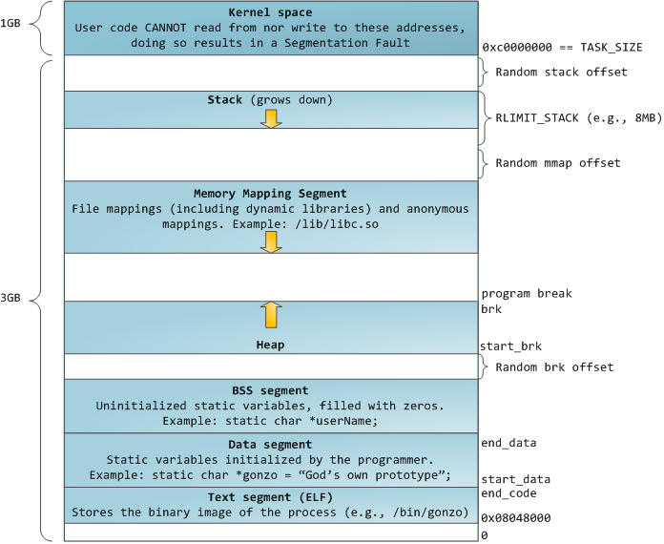

Slide 65
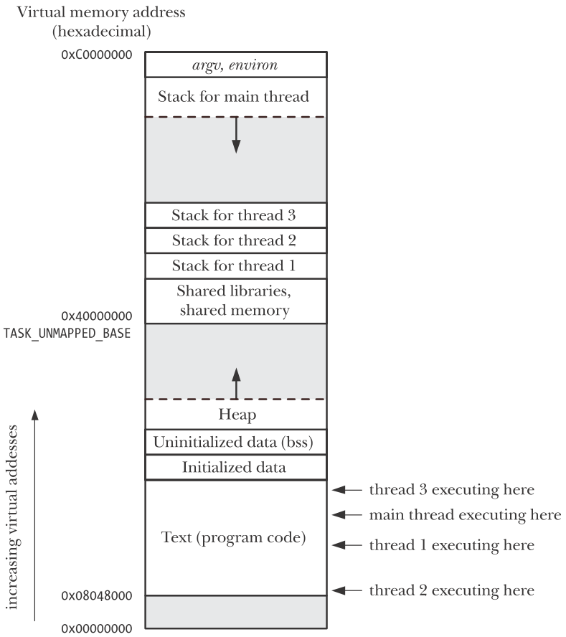

Slide 66

Process’s
Physical
Storage
view of memory
Virtual Memory
Virtual-to-Physical
Translations
Disk
MOV [ebx], eax
(via Page Tables)
System Memory
(part of Physical
Address Space)
CR2 _{LRU}
(Least
Processor puts
faulting address
(VA) in CR2
Recently
Used)

Slide 67

Blue Process’s
view of memory
Physical
Storage
Green Process’s
view of memory
Virtual Memory _{Disk}
Virtual Memory
Virtual-to-Physical
Translations
Virtual-to-Physical
Translations
(via Page Tables)
(via Page Tables)
System Memory
(part of Physical
Address Space)

Slide 68
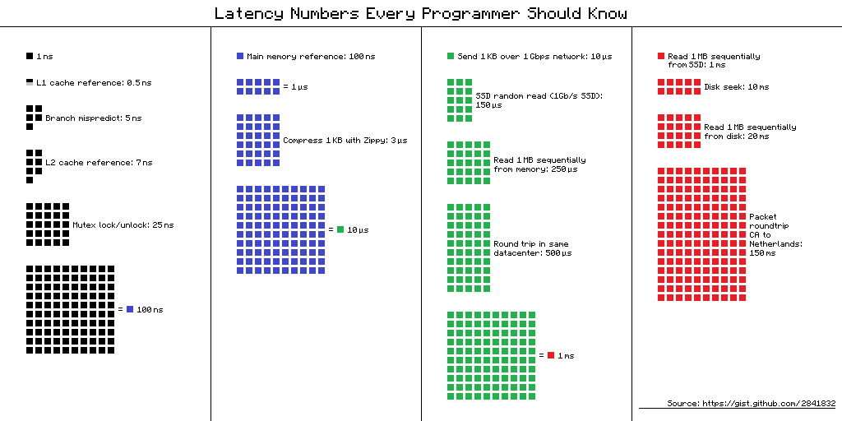

Slide 69
